Slide 1
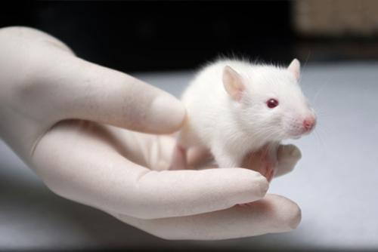
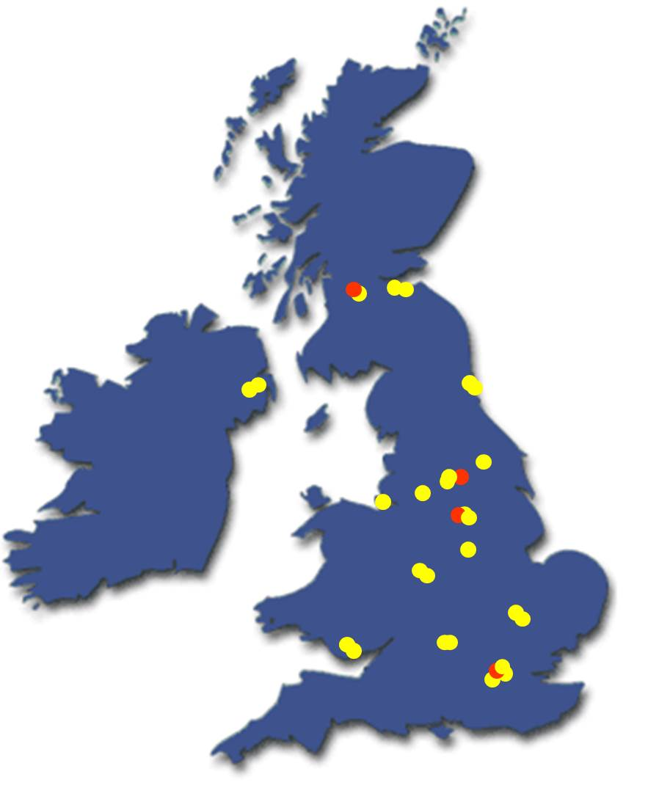
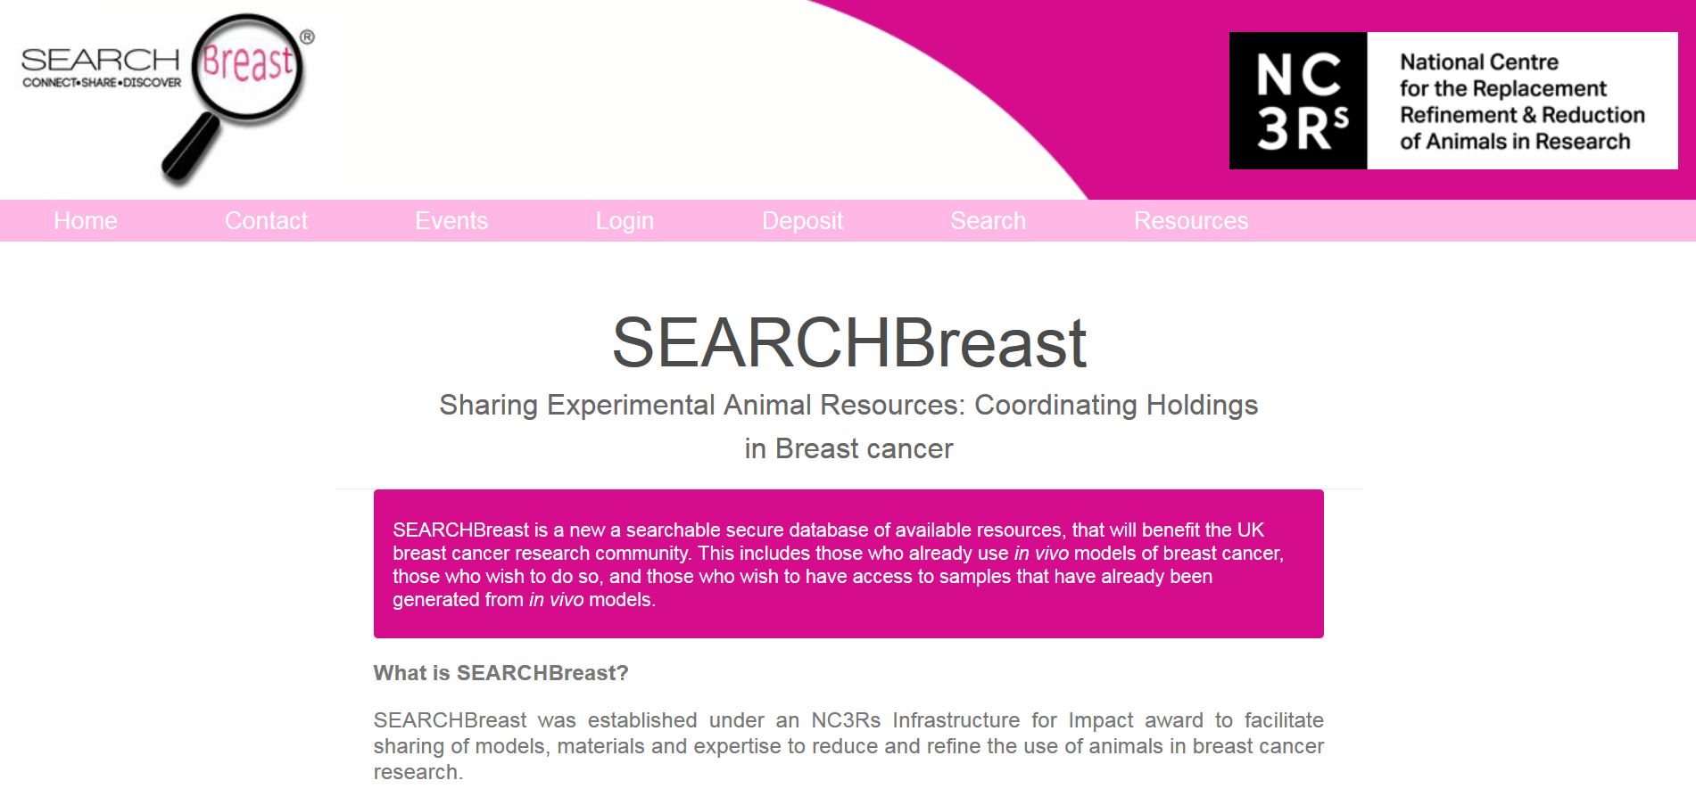
SEARCHBreast: a new resource to facilitate sharing of archived material derived from in vivo breast cancer models.
Bethny Morrissey¹, Karen Blyth², Phil Carter³, Claude Chelala³, Ingunn Holen⁴, Louise Jones³ and Valerie Speirs¹.
¹Leeds Institute of Cancer and Pathology, University of Leeds, Leeds, UK. ²Cancer Research UK Beatson Institute, Glasgow, UK. ³Barts Cancer Institute, London, UK. ⁴Academic Unit of Clinical Oncology, University of Sheffield, Sheffield, UK.
Replacement, Refinement and Reduction of animals in science research
SEARCHBreast: Connect. Share. Discover.
Over 3.7 million animals are used in scientific research each year in the UK alone¹. Some 20-30% of research council funding including the MRC, BBSRC and Wellcome Trust involves the use of animals².
In the past 5 years over 200 original research articles were published which used animal models of breast cancer in the UK³.
There is growing support amongst researchers, government and the general community to consider the Replacement, Refinement and Reduction (the 3Rs) of animals in research when designing or embarking on new in vivo experimentation.
Members will be able to log onto the SEARCHBreast database and enter details of available material to share.
Researchers seeking material can log onto SEARCHBreast and search for the relevant model and/or tissues which are available to share. Search results will display details of appropriate materials.
The owner of the material can then contact the searcher directly to begin communication. SEARCHBreast to be acknowledged for any collaborations forged.
Deposit
A Virtual Resource
SEARCHBreast won’t physically store available material. It will store information about the material. Material will remain with and under the ownership of the contributor.
SEARCHBreast: Sharing Experimental Animal Resources; Coordinating Holdings in breast cancer
Search
The SEARCHBreast initiative:
was established to impact the 3Rs through connecting breast cancer researchers with a view to sharing their surplus archival materials on a collaborative basis.
Connecting Researchers
is a collaboration between four research institutes across the UK.
SEARCHBreast will then contact the owner of the material on the searcher’s behalf, informing them of a potential connection.
has cultivated a membership of over 40 UK breast cancer researchers with collective expertise in:
genetically engineered,
transplantation, and
syngeneic
mouse models of breast cancer.
SEARCHBreast will address the 3Rs by:
Fostering a culture of increased sharing of models, material, and expertise; accelerating breast cancer research and reducing the number of animals used.
Promoting the use of 3D multicellular tissue culture models, derived from human breast material (collected with ethical approval) as replacement alternatives to animal models.
Providing on-line resources that promote emerging refinement technologies to the breast cancer community. SEARCHBreast will encourage its members to share ideas on how improvements to animal welfare could be achieved.
www.searchbreast.org
A secure searchable web-based platform of animal resources relating to breast cancer has been developed.
Join SEARCHBreast!
Members can either be contributors, searchers, or a combination of both.
For more information or to join our mailing list please contact us:
www.searchbreast.org
help@searchbreast.org
References
Acknowledgements
1. UK Home Office data 2011.
2. ‘Evaluating Progress in the 3Rs:
The NC3Rs Framework’
3. Pub Med May 2013
Funding for SEARCHBreast is provided by the NC3Rs under the ‘Infrastructure for Impact Awards’ scheme.

